Slide 1
243
Notes:
Good Afternoon Everyone,
To those who just came in this session, let me introduce myself again.
My name is Mark Cabanlit, I am a research associate from the University of the Philippines located in the City of Cebu.
Today I am going to be talking about my study entitled: Improving River Navigation Systems While Preserving Oyster Farms: A Site Suitability Analysis for Aquaculture Features along Hinigaran River
Here is the flow of my discussion for this session. Introduction, Methodology, Results, conclusion and recommendation.
So what do we want to achieve? Well first of all, I had the idea of creating this study when during one of our field validation, we were in a boat along the Hinigaran River however it was very difficult to navigate due to a lot of aquaculture along the river such as but not limited to fish pen, tidal set net, oyster culture and many more. I found out later that day the aquaculture along the river is now becoming a major problem of the local government unit. You know why? Because as what a member of the local government unit in Hinigaran, told me. The presence of aquaculture was defeating the purpose of their river which is actually one of their passage ways to other parts of the city. So they told me that they are already passing a city ordinance about the removal of these aquacultures. However, there is one major problem, some of the fisherfolks have been relying on these aquaculture as source of their food and livelihood. Fortunately enough, they will be allowing only 1 type of aquaculture which is oyster culture to still be built as long as it is in their suggested buffer zones.
So in order to help in the decision making about where we can add more of theses features, we needed to produce suitable sites for oyster culture in order to maximize the use of the buffer zones of the river.
This is basically just a suggestion to the local government unit in their river cleanup efforts of the local government unit of our study site which is the municipality of Hinigaran. It is in Negros Occidental in Visayas portion of the Philippines.
So for the methodology. There are 10 layers involved in the selection of suitable areas along Hinigaran River for river-based aquaculture. Each layer was reclassified to produce a shapefile with 1 to 5 ratings were 5 is the most suitable and 1 is the least suitable. The first 9 of these layers are from the provincial planning and development office of Negros Occidental.
First we have is vulnerability to flooding, Land Suitability, Vulnerability to Erosion, Land Cover, Tsunami Vulnerability, Slope Classification, Type of Soil, Rain Induced Landslide, SAFDZ, and distance to Mangroves which was an output of the Phil-LiDAR 2 program with the process workflow from Pada et al (2015).
All layers were then used as input for the Union function in ArcMap. The Union function created a geometric union of the input features. Afterwards, a suitability field was then added to the attribute of the resulting shapefile. The resulting attribute yielded values ranging from 5 to 1. Values greater than 4.5 and less than 5 was considered acceptable.
Now we can identify which portion of the river is most suitable or safest to build structures.
For the image processing section of the study, we used the Digital Surface Model and the slope derivative which was derived from the elevation values from the DSM.
The image was segmented between data and no data first. Afterwards, all objects containing LiDAR data was then segmented using multi-resolution segmentation with 5 as layer weight for Digital Surface Model and 1 as layer weight for slope. Thematic layers for River, buffered zone which is 15 meters from the river banks as suggested by the LGU, and output suitable area with suitability value greater than 4.5 was also included in the segmentation. The scale parameter for the multiresolution segmentation was set to 100 while the composition of homogeneity criterion for shape was set to 0.1 and compactness to 0.5
The DSM was used to separate the land features from water. All suitable buffers were then segmented using Chessboard segmentation with 10 as the object size. The candidate class was then exported together with their slope values. In other terms, we performed chessboard segmentation on the buffer zones of the suitable sections of the river. These classified zones that are suitable were used as candidates for our suitability analysis for oyster culture.
If we are to calculate the mean slope of each of the object under the chessboard segmentation, we arrive with the last image on the screen.
As a result we now have a suitability map. Those that are colored in green has a slope of less than 8 are or will be considered as suitable since oyster culture needs to be in flat surfaces.
Through overlay analysis and image processing, a suitability map for oyster culture has been generated along Hinigaran River. By performing overlay analysis on the layers discussed, a suitability layer was generated along Hinigaran River. The suitability map was then used in image processing to identify portions of the river that are suitable for oyster culture through the slope layer derived from the Digital Surface Model. It was then found out that some of the suitable areas generated has oyster culture, the remaining area can be utilized in expanding the oyster culture along Hinigaran River. This map can be turned over to the local government unit of Hinigaran in order to aid them in the decision making for the rehabilitation of Hinigaran River in terms of navigation and river-based aquaculture.
For our recommendations: A larger area with more oyster culture would be beneficial to the study. Since there is not that much research regarding oyster culture suitability using remote sensing, we can extract the oyster culture features and then learn from the characteristics of the extracted features much like machine learning. Both slope and depths should be checked since features might have lesser slope values but they might generally have lower depth values making them deeper. There are a lot more biological factors that are involved in oyster culture and it would be better if these would be considered. These factors were not included due to the time and financial constraints of the research. The result of this study cannot be treated as the absolute true situation. But it provides a mean to help the decision maker(s) to makes the right choice.
I would like to thanks the following:

Slide 2

University of the Philippines Cebu
Phil – LiDAR 2
Improving River Navigation Systems While Preserving Oyster Farms:
A Site Suitability Analysis For Aquaculture Features Along Hinigaran River
M. A. Cabanlit
Research Associate

Slide 3
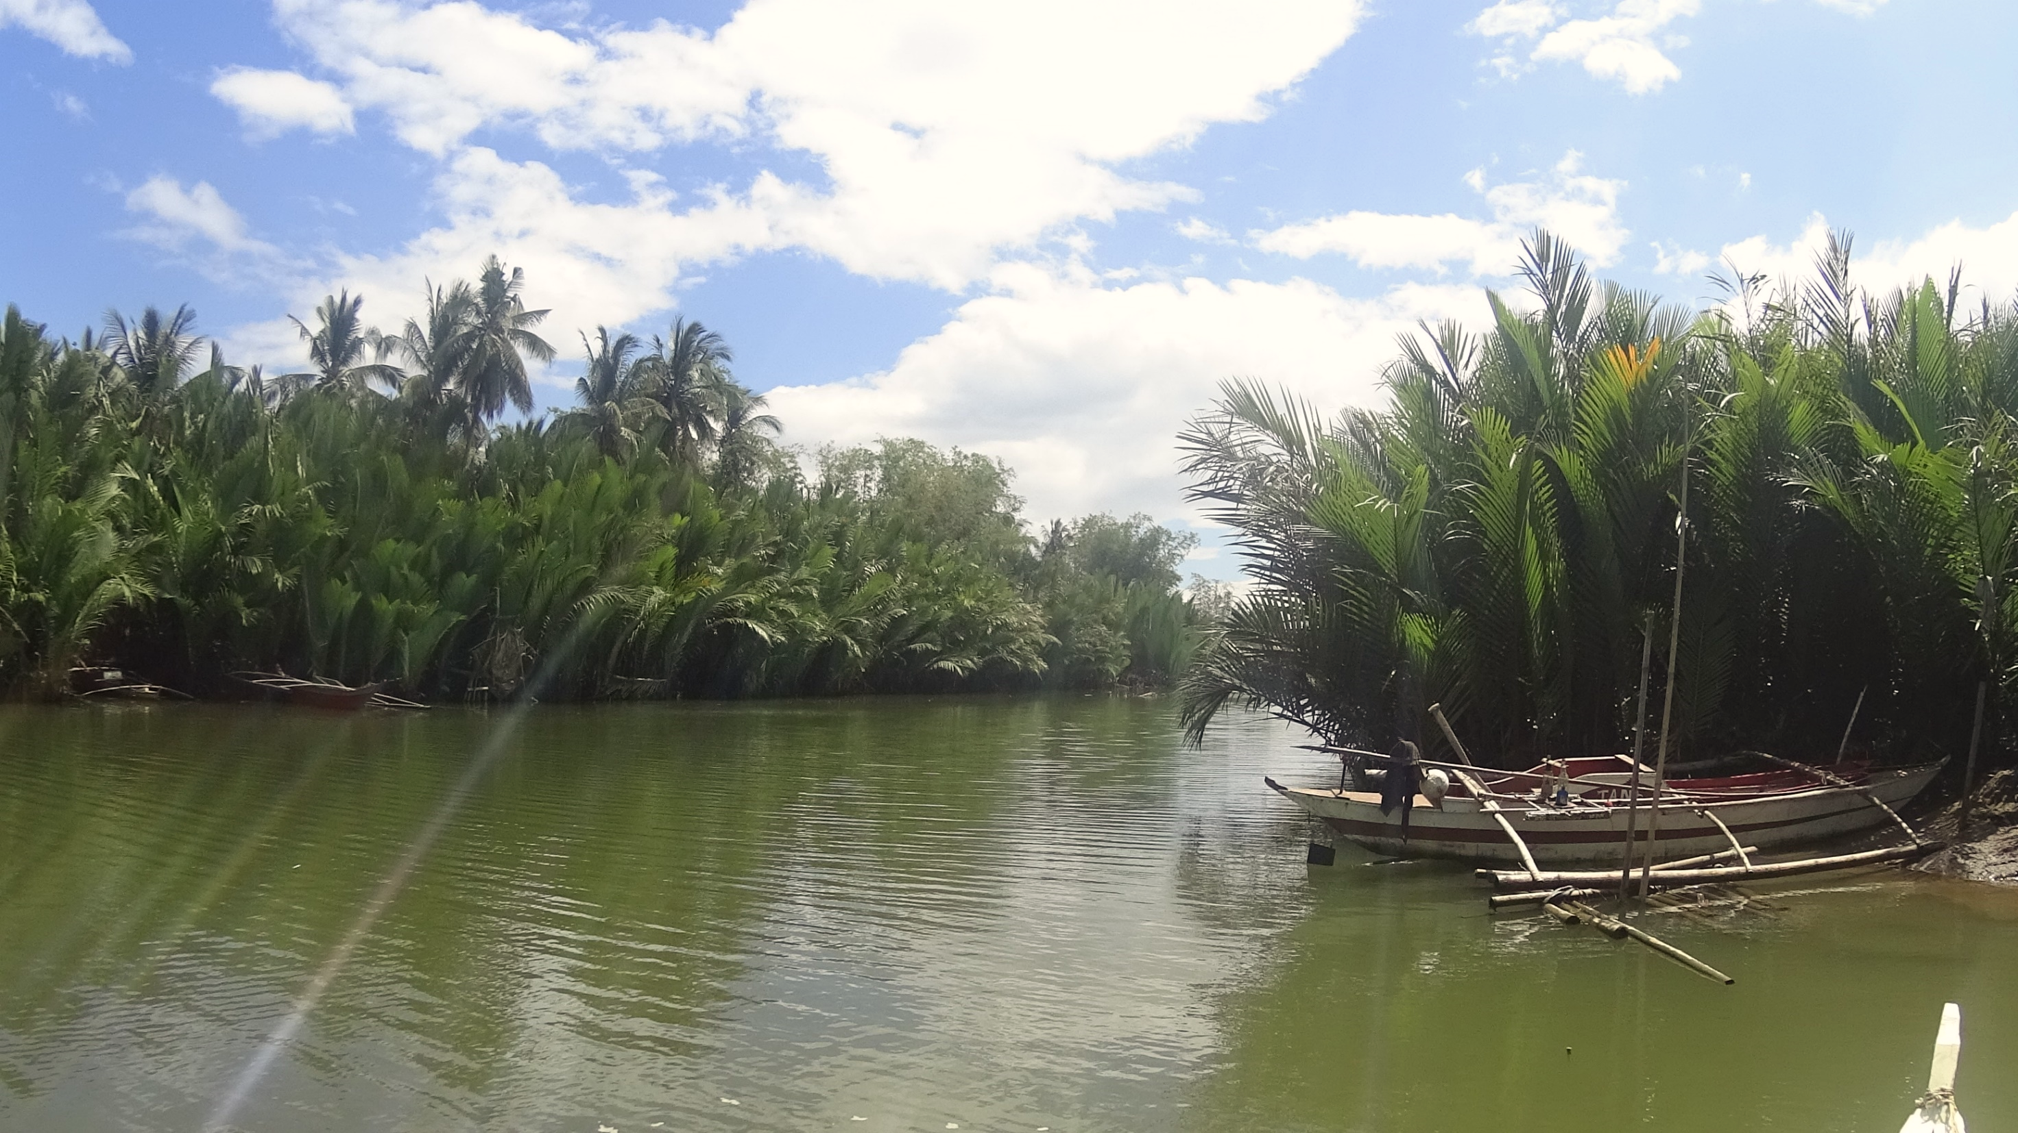
Contents
01
Introduction
02
Methodology
03
Results
04
Conclusion
05
Recommendations
4

Slide 4
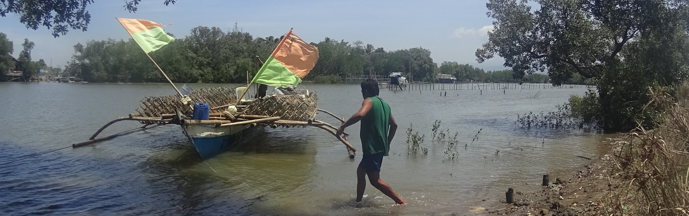
Produce Suitable Sites
for
Oyster Culture
What do we want to achieve?
Introduction

Slide 5
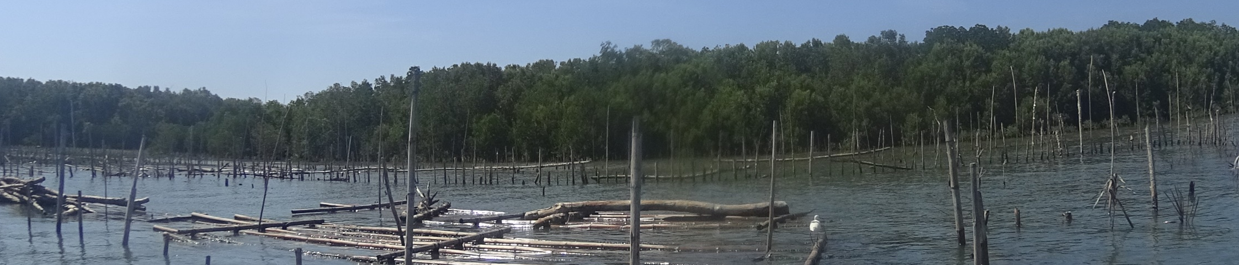
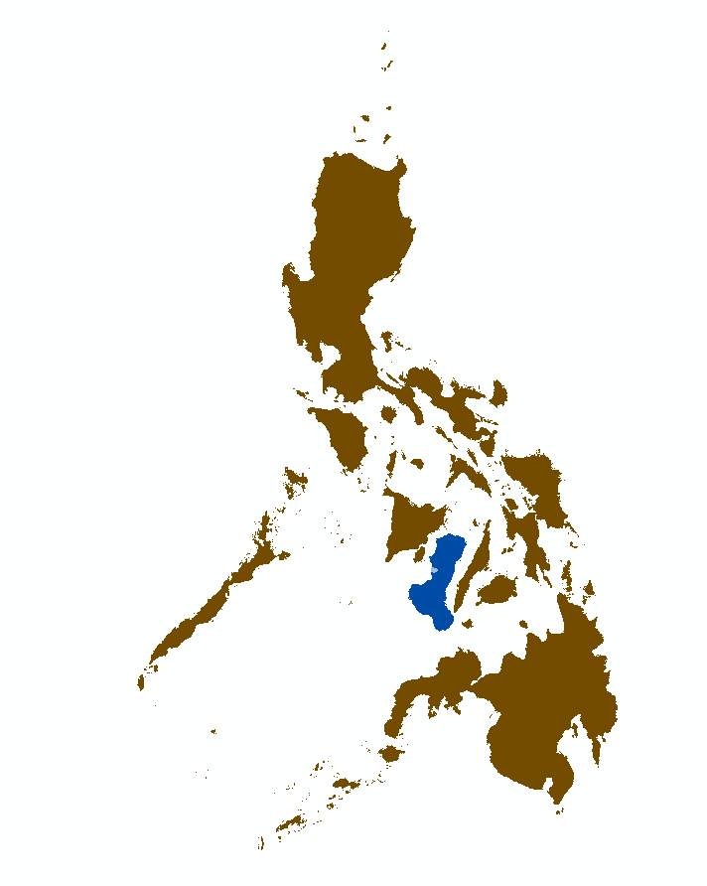
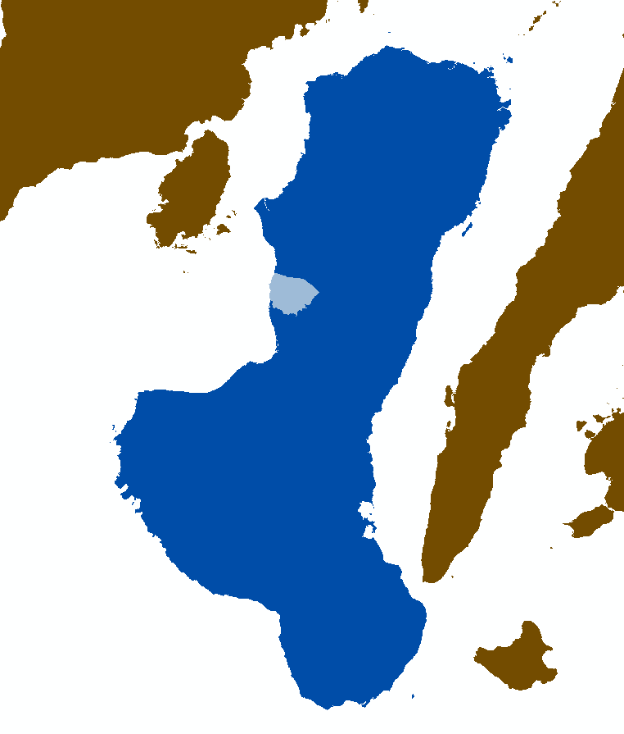
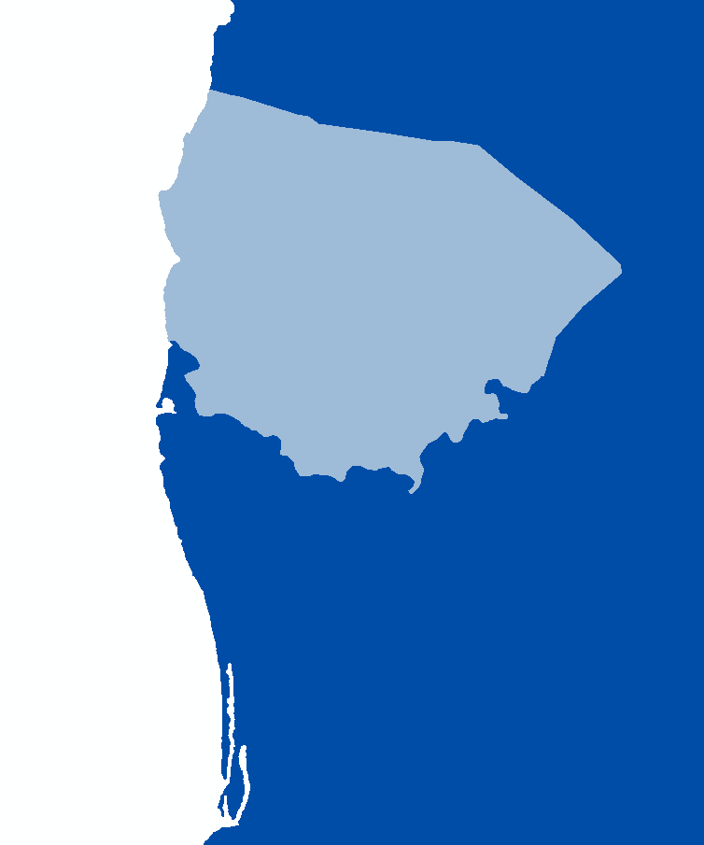
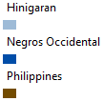
Study Site
Municipality of Hinigaran
4

Slide 6

Methodology

Slide 7


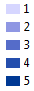



Layers Involved
5 = Most Suitable; 1 = Least Suitable
Vulnerability to Flooding
Land Suitability
Vulnerability to Erosion
Land Cover
Tsunami Vulnerability
6

Slide 8





Layers Involved
5 = Most Suitable; 1 = Least Suitable
Distance to Mangroves
SAFDZ
Rain Induced Landslide
Type of Soil
Slope Classification
7

Slide 9

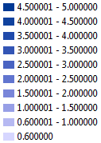
Union
For All Image Layers

Slide 10
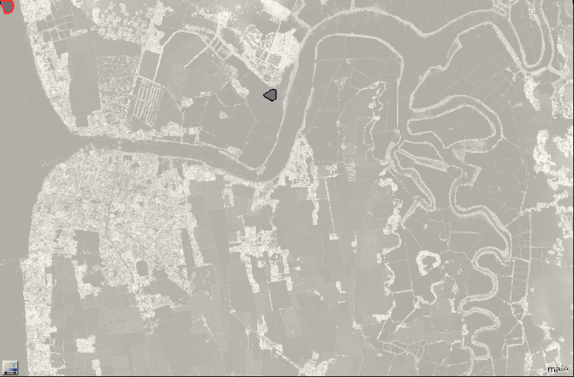
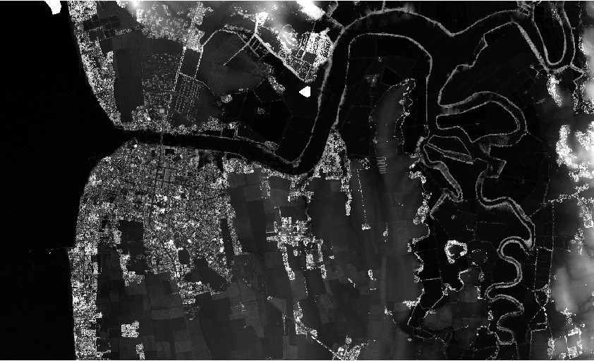
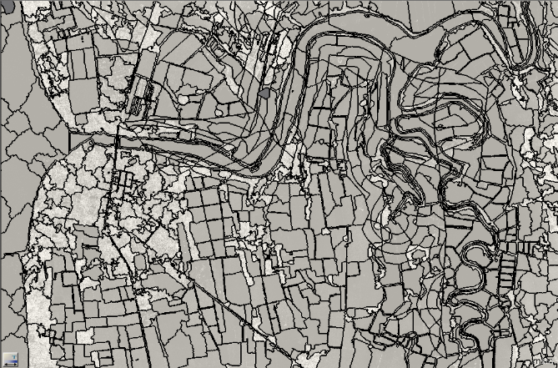
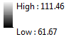
Image Processing
Using ECognition
LiDAR
Derivatives
Seg
mentation
Data vs.
No Data
9

Slide 11
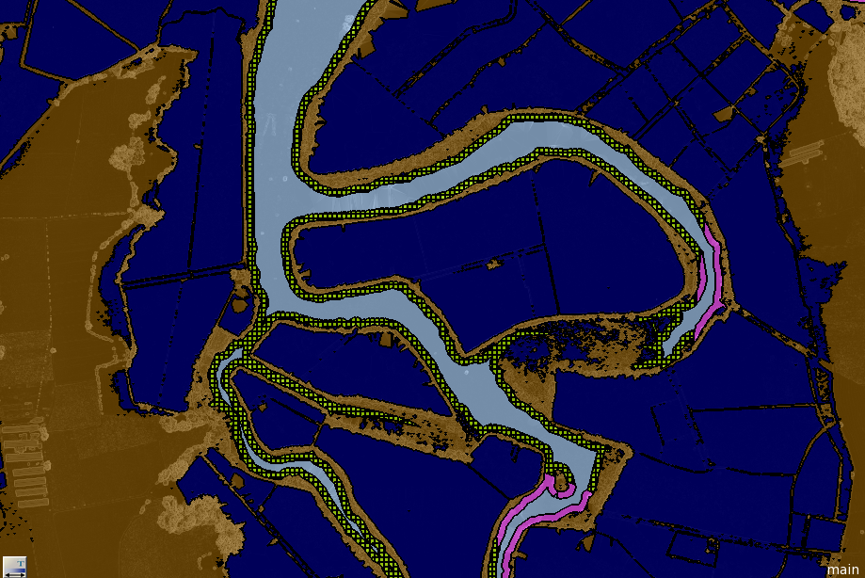
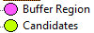
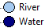
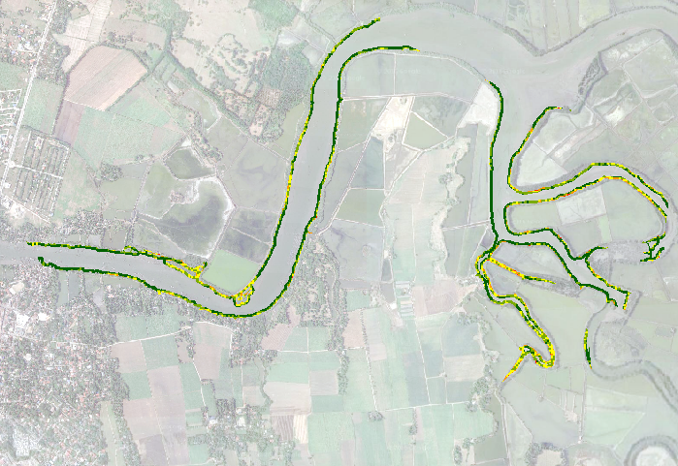
Land vs.
Water
ification
Class
board
Chess
10

Slide 12
Results

Slide 13
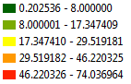

Slide 14
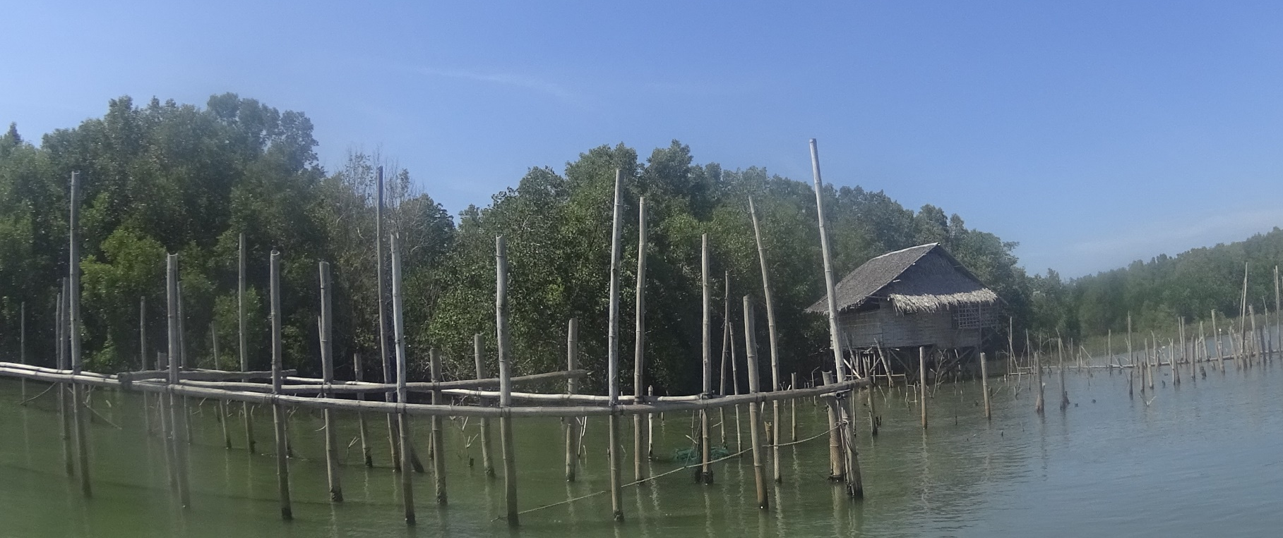
Conclusion
Through overlay analysis and image processing, a suitability map for oyster culture has been generated along Hinigaran River.

Slide 15
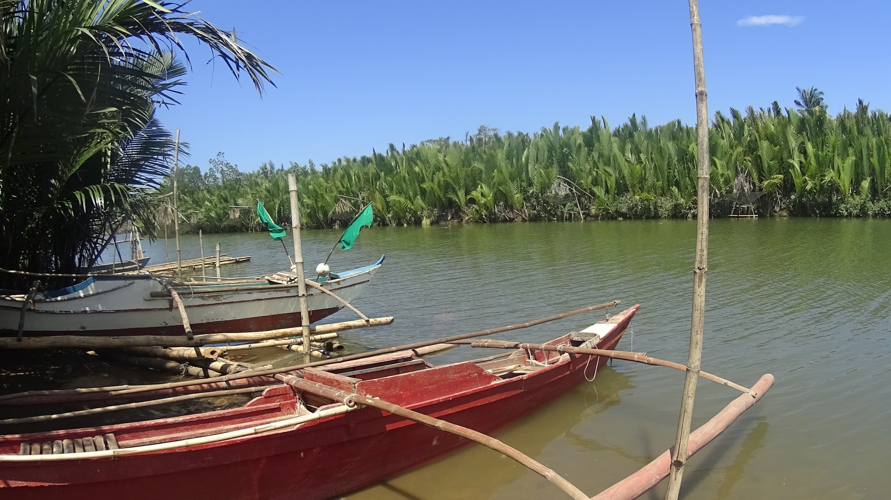
Recommendations
01
Larger Study Area
02
Try learning from Extracted Features
03
Consider using Depth
04
Consider biological factors
05
Create accuracy assessment
14

Slide 16
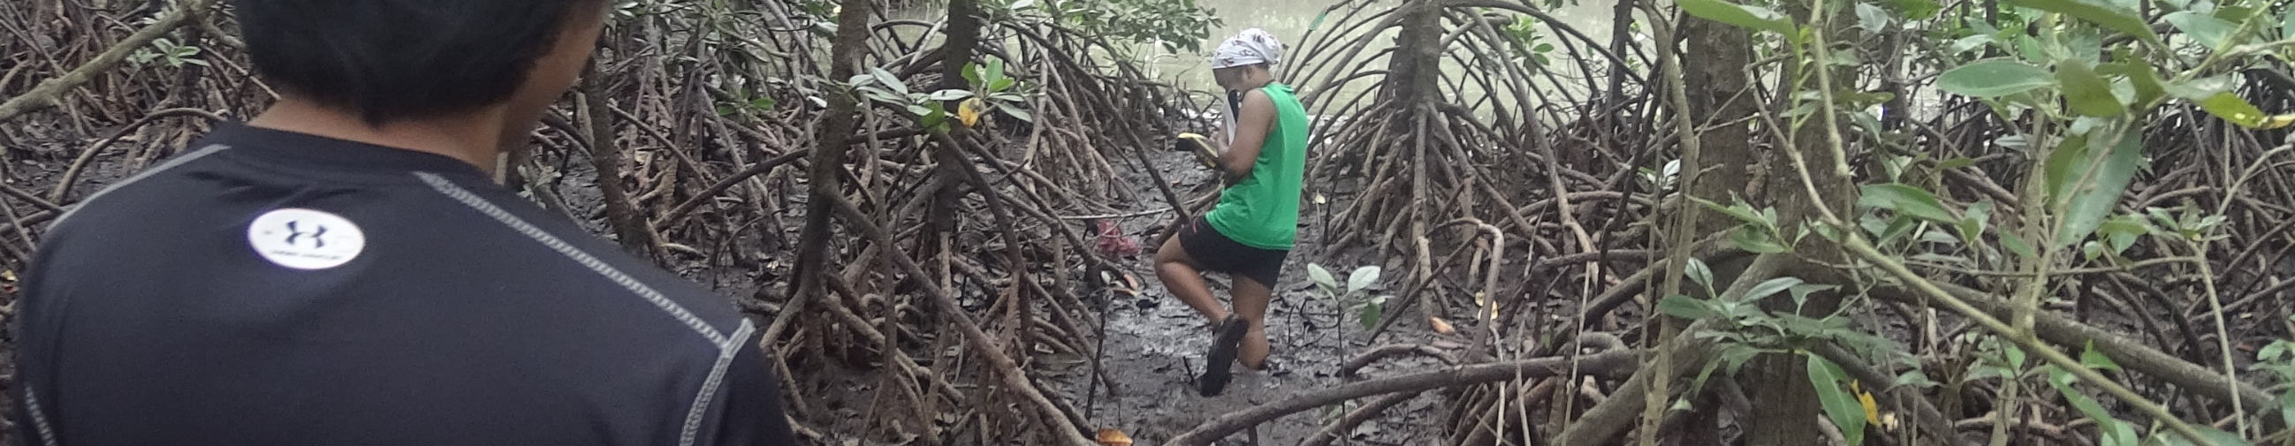





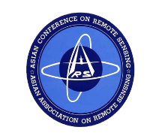
Acknowledgements
I would like to thank the following:
Department of
Science and Technology
Asian Conference
on Remote Sensing
Funding Agency
Secretariat
Deparment of
Science and Technology –
The Philippine Council for Industry, Energy, and Emerging Technology Research nad Development
Phil-LiDAR 2
Project
University of the Philippines
Cebu
Monitoring Agency
Asian Associate
On Remote Sensing
15

Slide 17
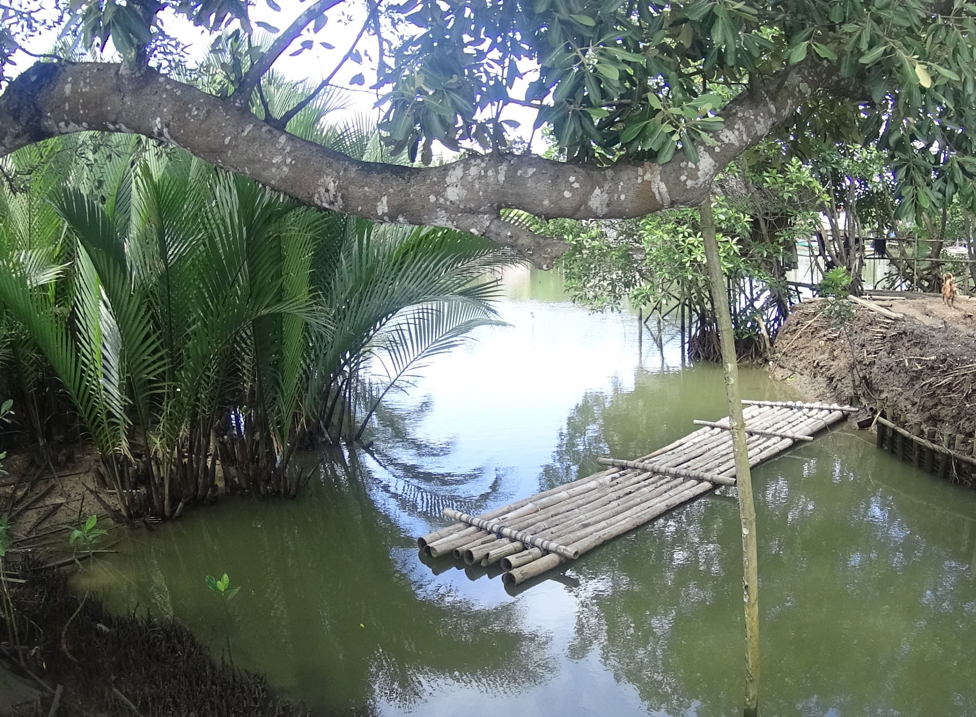
Questions?
https://ph.linkedin.com/in/mcabanlit
mharkiecabanlit@gmail.com

Slide 18
Thank you!

